Slide 1
ENHANCING CUSTOMER OUTREACH BY USING SOCIAL MEDIA/P2P NETWORK
PIP2001 Capstone Project
Batch Number: ISE-12
Roll number | Student Name
20211ISE0017 | Anushree G
20211ISE0018 | Hemalatha K
20211ISE0055 | Supriya D
Under the Supervision of,
Prof. Saptarsi Sanyal
Assistant Professor
School of Computer Science and Engineering
Presidency University
Name of the Program: Information Science and Engineering(ISE)
Name of the HoD: Dr. Pallavi R
Name of the Program Project Coordinator: Srinivas Mishra
Name of the School Project Coordinators: Dr. Sampath A K / Dr. Abdul Khadar A / Mr. Md Ziaur Rahman

Slide 2
Introduction
The project aims to bridge the gap in customer engagement in insurance industries by integrating social media platforms with decentralized, secure communication frameworks from peer-to-peer networks. This approach allows businesses to communicate in real-time, offering personalized updates and ensuring privacy and security. The system will identify non-contactable customers, particularly those with pending policy renewals or unclaimed benefits, and reach them through both platforms, improving customer outreach efficiency and satisfaction.

Slide 3
Literature Review
Social Media in Customer Engagement
Peer-to-Peer (P2P) Networks for Communication
Combining social media and P2P Networks
Data Analytics for Customer Identification
Privacy Concerns and Compliance
Customer Outreach in the Insurance Industry

Slide 4
Existing method Drawback
Social Media Marketing Tools (e.g., Hootsuite, Buffer)
Drawbacks: These tools are often focused on scheduling and posting content but lack deep personalization and automation capabilities. Furthermore, they may struggle with managing real-time, large-scale interactions.
Chatbots on Social Media
Drawbacks: While chatbots automate some customer interactions, they are often rigid and provide generic responses, lacking deep personalization. They also do not integrate well with decentralized platforms.
Peer-to-Peer Communication Tools
Drawbacks: While P2P networks offer secure communication, they are typically not used for customer outreach and lack integration with social media for seamless business interactions.
AI-based Social Media Algorithms
Implement real-time analytics to assess customer sentiment, interaction success, and overall outreach effectiveness

Slide 5
Objectives
Automate Customer Engagement: Design a system to automate customer
outreach through social media and P2P channels.
Personalized Interactions: Tailor interactions and recommendations based
on customer preferences and behaviour
Enhance Security: Use P2P networks to ensure secure data exchanges between
customers and businesses, protecting customer privacy.
Scalability and Efficiency: Develop a scalable architecture to handle large
numbers of interactions while optimizing system efficiency.
Analytics and Feedback: Implement real-time analytics to assess customer
sentiment, interaction success, and overall outreach effectiveness

Slide 6
Methodology/Modules
Data Collection and Identification
Social Media Integration
Peer-to-Peer (P2P) Network Development
Automation of Customer Engagement
Data Analytics and Predictive Modelling
Testing and Optimization
Privacy, Compliance, and Security
Full-Scale Deployment

Slide 7
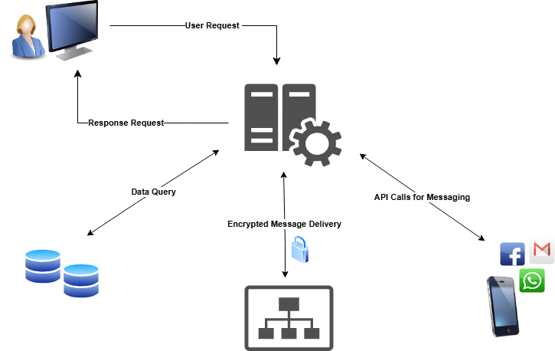
Architecture
Fig 1.1 WorkFlow Architecture

Slide 8
Hardware/software components
Software :
Operating System: Windows 10/11, macOS, Linux (Ubuntu for production).
Development Tools: VS Code, Git, npm.
Backend Dependencies: Node.js, Express.js, Mongoose.
Frontend Dependencies: React.js, React Router, Redux, Tailwind Css.
Database: MongoDB or MongoDB Atlas
Deployment Tools: Netlifty.
Hardware :
Processor: Modern multi-core processor (e.g., Intel i5/i7 or AMD Ryzen).
RAM: At least 4GB (8GB preferred for smoother performance).
Network: Reliable internet connection for downloading dependencies, libraries, and accessing APIs.

Slide 9
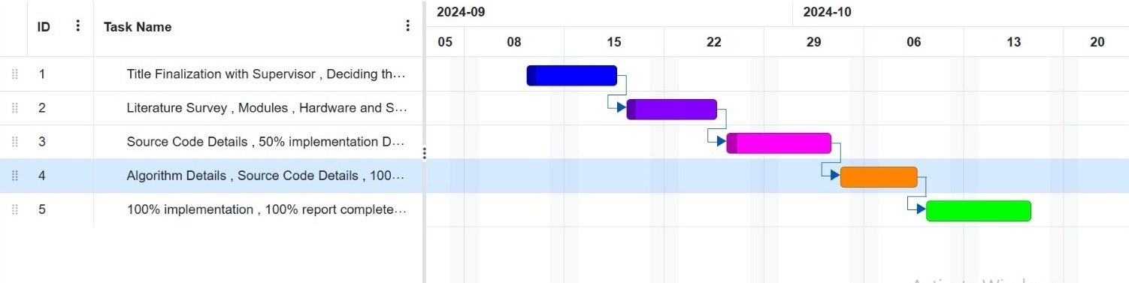
Timeline of Project
Fig 1.2 Gantt Chart

Slide 10
Outcomes
Improved Customer Outreach: The integration of social media platforms and P2P networks will significantly increase engagement with previously non-contactable customers, enabling businesses to reach out more effectively with personalized communication.
Enhanced Data Privacy and Security: With the decentralized P2P network, customer data exchanges will be more secure, ensuring compliance with data privacy regulations and minimizing risks of breaches.
Increased Customer Retention: By sending personalized, timely notifications about policy renewals, bonuses, and unclaimed maturities, businesses will experience improved customer retention and satisfaction.
Automation of Communication: The AI-driven system will automate customer interactions, reducing the manual effort required and ensuring a more efficient communication process.
Scalability: The platform's design will allow businesses to handle an increasing number of customers and interactions, offering a sustainable outreach model as the customer base grows.

Slide 11
Conclusion
The initiative aims to enhance customer outreach in insurance and banking sectors by integrating social media platforms and peer-to-peer networks. This approach allows for personalized, modern, and scalable communication channels, enhancing customer retention and satisfaction. Social media provides timely notifications in insurance, while P2P networks offer secure, decentralized data exchange. In banking, similar outreach is crucial for informing clients about important updates. The decentralized nature of P2P networks adds security, safeguarding customer data and ensuring regulatory compliance with privacy laws like GDPR. This reduces the likelihood of data breaches and allows businesses to scale outreach efforts while minimizing operational costs and maintaining trust. This system addresses unique challenges in customer communication, ensuring long-term benefits like improved operational efficiency, lower costs, and higher customer loyalty.

Slide 12
References
[1]. Ariponnammal, S. and Natarajan, S. (1994) ‘Transport Phonomena of Sm Sel – X Asx’, Pramana – Journal of Physics, Vol. 42, No. 1, pp. 421-425.
[2]. Smith, J. and Brown, M. (2022) ‘Decentralized Communication Systems: A Peer-to-Peer Approach’, Journal of Network Architecture and Design, Vol. 45, No. 3, pp. 123-135.
[3]. Johnson, A. (2021) ‘Leveraging Social Media APIs for Customer Engagement’, International Journal of Digital Marketing, Vol. 30, No. 5, pp. 211-224.
[4]. Patel, M. (2023) ‘Secure Data Transmission in P2P Networks: Techniques and Applications’, Journal of Cybersecurity Advances, Vol. 12, No. 2, pp. 89-105.
[5]. Gupta, R.K. and Sharma, S.D. (2020) ‘The Role of MongoDB in Scalable Data Management’, Database Technologies and Applications, Vol. 18, No. 7, pp. 45-57.
[6]. Harris, T. and Clark, L. (2022) ‘Comparative Analysis of Traditional and Automated Customer Outreach Methods’, Journal of Business Communication Strategies, Vol. 28, No. 4, pp. 123-140.
[7]. Lee, S., Davis, R., and Kim, H. (2022) ‘Real-Time Communication Using Node.js: A Case Study’, Proceedings of the International Conference on Web Technologies, pp. 89-98.
[8]. Davis, J. (2021) ‘Improving Customer Retention Through Personalized Messaging’, International Journal of Customer Relationship Management, Vol. 25, No. 3, pp. 67-78.

Slide 13
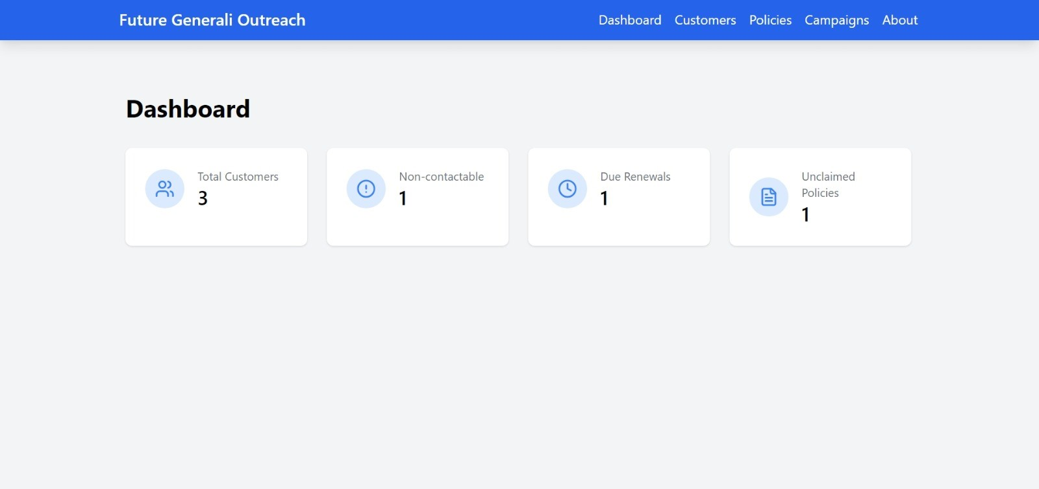
Fig 1.1 Dashboard

Slide 14
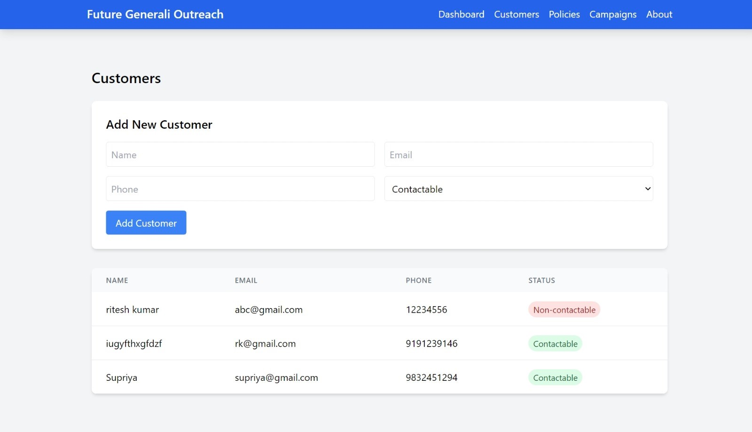
Real-World Impact
Fig 1.2Customers

Slide 15
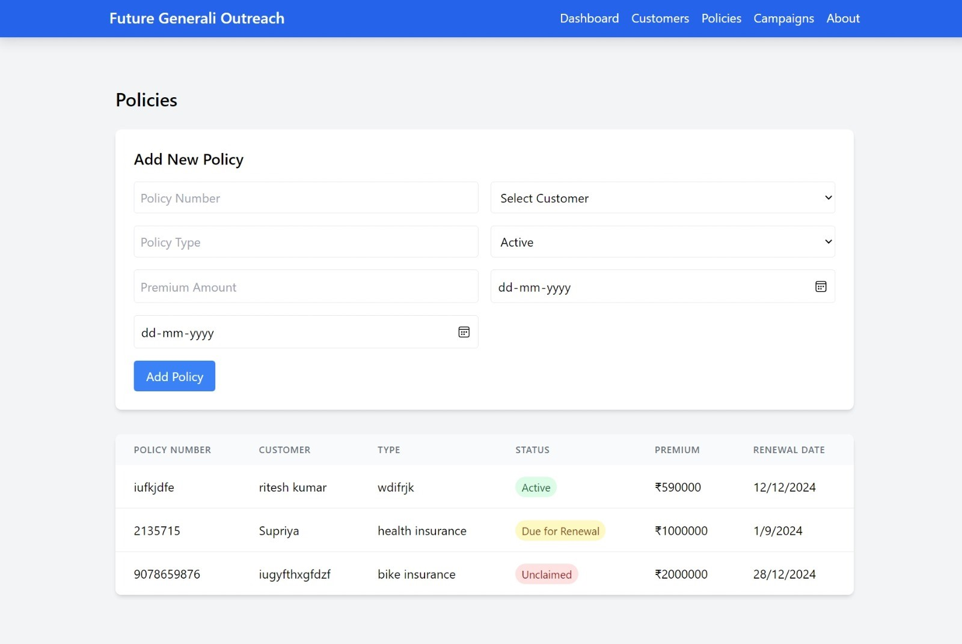
Fig 1.3 Policies

Slide 16
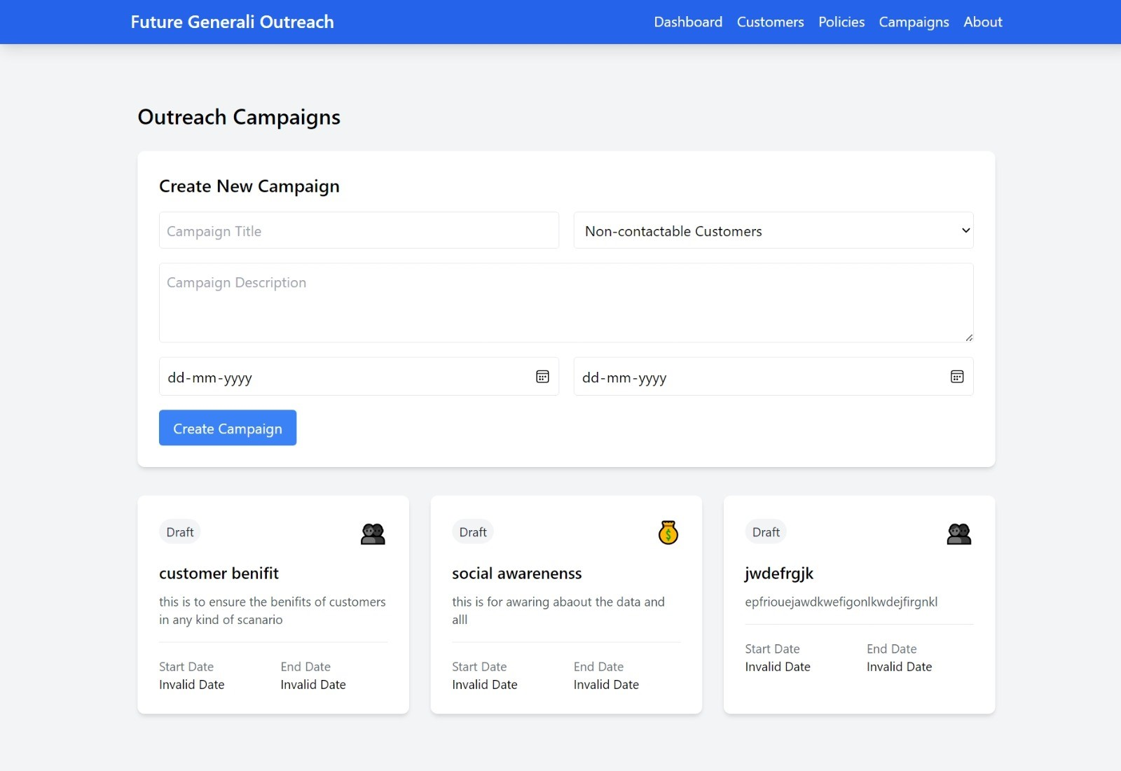
Fig 1.4 Outreach Campaigns

Slide 17
Thank You

